Slide 1
GP CPCS

Slide 2
Aims
Free up GP appointments
Self-care narrative of NHS
Signposting via official pathway
Build relationship with pharmacies

Slide 3
Service Overview
https://view.vzaar.com/22504178/player

Slide 4
Pathway

Slide 5
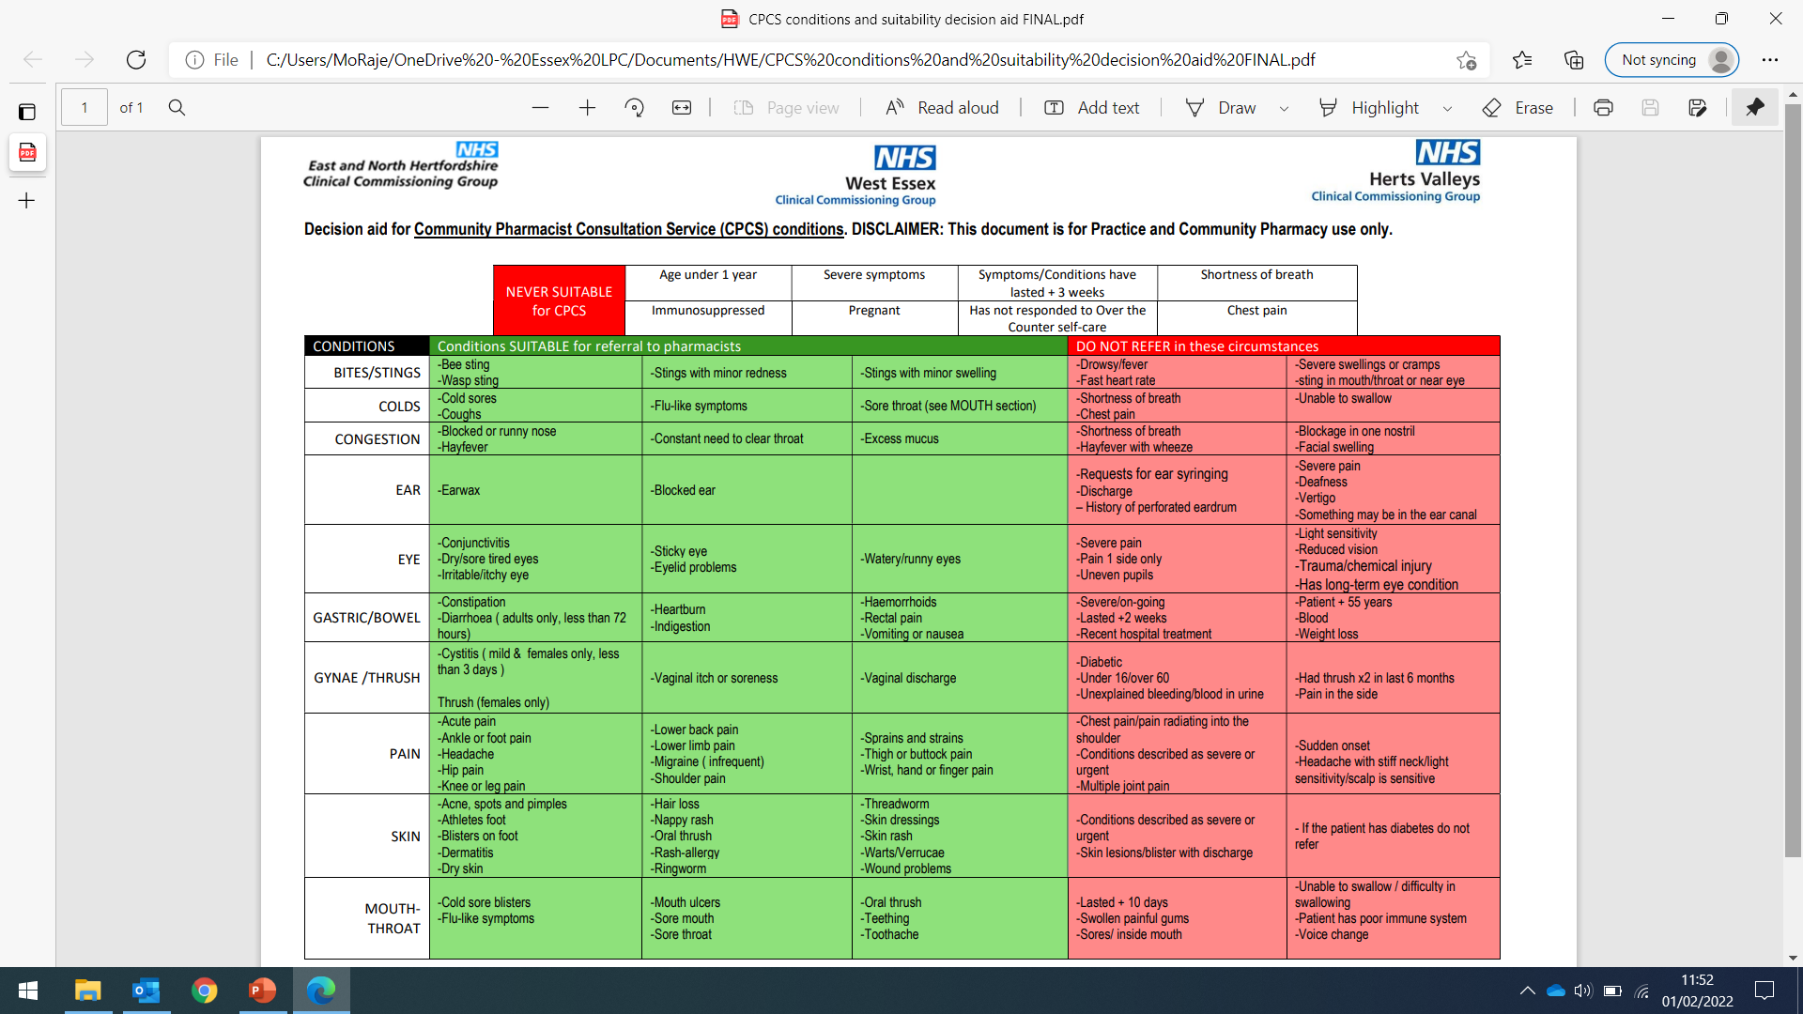

Slide 6
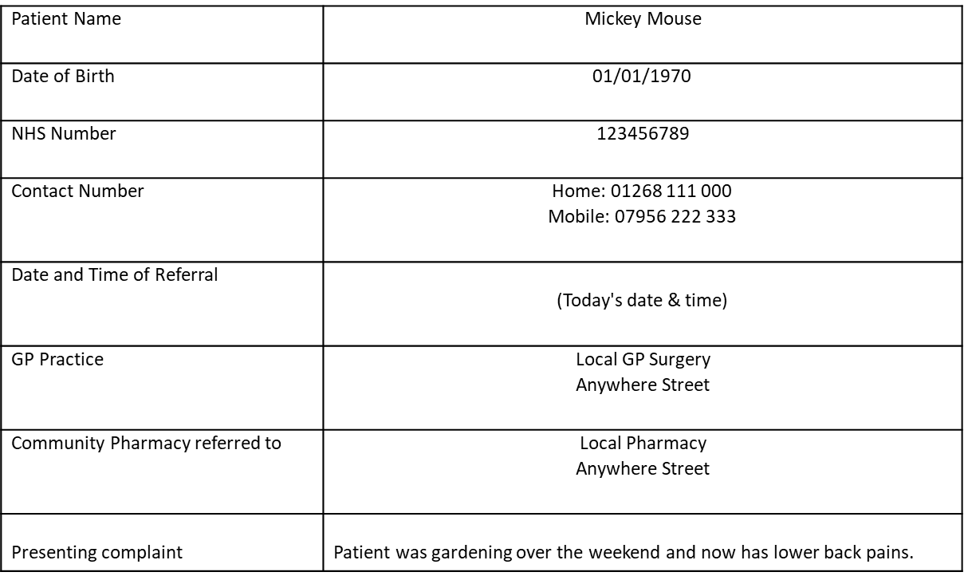
NHS email

Slide 7
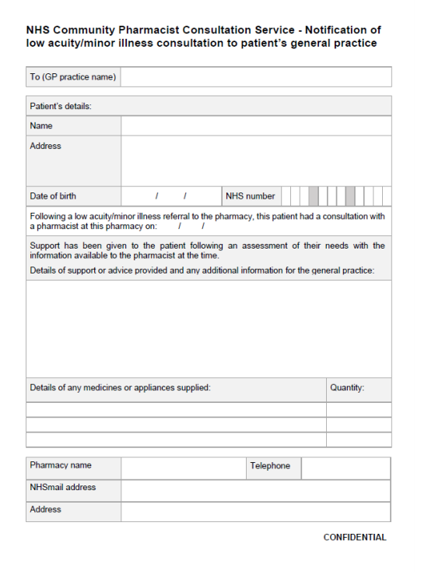
Summary Sheet

Slide 8
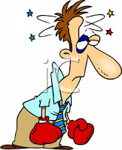
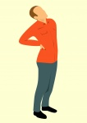
Consultation Outcomes
Advice only
Advice + Sale of an Over The Counter (OTC) Product
Advice + Signpost
Advice + Refer
Adult with Sleep Difficulties - during consultation patient explains recently started working shifts or new mother and discussion with pharmacist leads to appropriate advice. All consultations end with “if”.
Adult with Headache - during consultation pharmacist eliminates red flags and identifies it as a tension headache. Pharmacist provides self care advice and suggests the patient buys paracetamol.
Patient with lower back pain - during consultation pharmacist eliminates red flags and provides self-care advice to the patient. They advise the patient that if it doesn't resolve then they may need to see a physiotherapist and explain how to access physio services in their local area.
Young adult male with headache but during consultation explains they received a blow to the head during boxing training the day before. Pharmacist contacts GP practice using the agreed number to refer the patient back to them.

Slide 9
A Little Less Conversation, A Little more Action
System 1 – https://youtu.be/6JhvEiOBJwA
EMIS – https://www.youtube.com/watch?v=pyQUfUR2lz0

Slide 10
Dose of Reality
Can be frustrating - especially at the start
settles down as everyone uses it more and more
The pharmacist may need to escalate the patient to a higher acuity care location (e.g. back to their GP or A&E). The pharmacist may contact you via ‘professional line’ asking for the practice to see a patient, if this happens support them – Have a couple of CPCS slots available in the afternoon.
No Children <1 year
No Ear Aches

Slide 13
Any Questions?

