Slide 1
Essex LPC conference 2019
Sli-do
Event number #X032

Slide 2
Essex LPC Conference September 2019
Gordon Hockey
Director of Operations and Support

Slide 3
Today
Last year’s questions
Short presentation – no substitute for the PSNC CPCF Roadshow
Quick look at business as usual regulatory requirements
Two additional topics
Theme - PSNC working with Essex LPC to support you as a contractor

Slide 4
What you said last year
Two biggest opportunities - Monitoring of long term conditions 45%, urgent care services (e.g. NUMSAS and DMIRS) 23% and Prevention-related activities 23%
Two biggest threats – lack of funding 62%, lack of HMG understanding of our potential 57% and technology 24%
What would your top two priorities public health/prevention services national commissioning – hypertension and AF identification and treatment 42% and NHS health checks 26%

Slide 5
Summary of the deal
£13bn funding secured (£2.592bn/year plus PhIF) – more than original Government plans
Expansion of clinical services begins with the Community Pharmacist Consultation Service (CPCS) secures the future of CP in the NHS
Stability and certainty to enable reform, puts us at the heart of primary care and gives us leverage for the future
Notes:
This deal with a £13bn investment removes ambiguity for contractors over the next five years and secures community pharmacies a future in the NHS.
We now have a clear vision for the sector’s development from our customer (Government) – this in line with our ambitions as per the Community Pharmacy Forward View.
A multi-year settlement was essential to provide a period of stability and certainty for community pharmacies and to allow the sector reform itself.

Slide 6
The PSNC Negotiating Team
PSNC Negotiating Team is elected by PSNC Committee and represents all parts of the sector
At every step, the Negotiating Team asked itself: “Is this in the best interests of community pharmacy contractors?”
PSNC highlighted contractors rising costs and viability, but HMG wants a more efficient dispensing service from fewer pharmacies

Slide 7
NHS Community Pharmacist Consultation Service (CPCS)
Roll out 29 October - NUMSAS + DMIRS - follow up calls to no-show patients reduced to one (from three) – PSNC template SOP
Transitional payment of:
£900 if signed up by 1st December 2019; or
£600 by 15th January 2020
You can now register via MYS
Fee of £14 per completed consultation
To pilot: expansion with referrals from GPs, NHS 111 online, Urgent Treatment Centres and possibly A&E

Slide 8
Clinical Services: Prevention and Medicines Optimisation
Level 1 Healthy Living Pharmacy an essential requirement by 1 April 2020
Hepatitis C testing to be introduced in 2019/20 and PhIF and PCN programme to test services
Medicines reconciliation service to ensure changes in medication made in secondary care are implemented when patient discharged into the community

Slide 9
Clinical Services: Medicines Use Reviews
MURs to be phased out as Structured Medication Reviews carried out by clinical pharmacists working within PCNs are introduced
Contractors will be able to provide up to
250 MURs during 2019/20 (max. 200 in H1)
100 in 2020/21
From H2 2019/20, 70% of MURs must be for patients taking high-risk meds or post-discharge

Slide 10
Quality: the Pharmacy Quality Scheme
QPS is re-named PQS
Annual value of £75m
Some quality criteria grouped into bundles for payment
Can claim advance Aspiration payment of up to 70% of QPS earnings from 2018/19
Claim via MYS from 30th September to 1st November
Payment on 29th November

Slide 11
PQS Gateway Criteria
Offering Flu Vaccination Service and/or NMS
Active shared premises NHSmail mailbox, with two linked accounts
Update NHS website profile within a defined time period
Level 2 safeguarding status for 80% of pharmacy professionals

Slide 12
PQS Bundles​
Risk Management and Safety Composite Bundle (30 points, min. £1920)
Medicines Safety Audits complementing the GP QOF QI (25 points, min. £1600)
Prevention domain (25 points, min. £1600)
Primary Care Networks (12.5 points, min. £800; 10 points for pharmacy PCN leads)
Digital enablers – NHS 111 DoS profile and SCR access (2.5 points, min. £160)

Slide 13
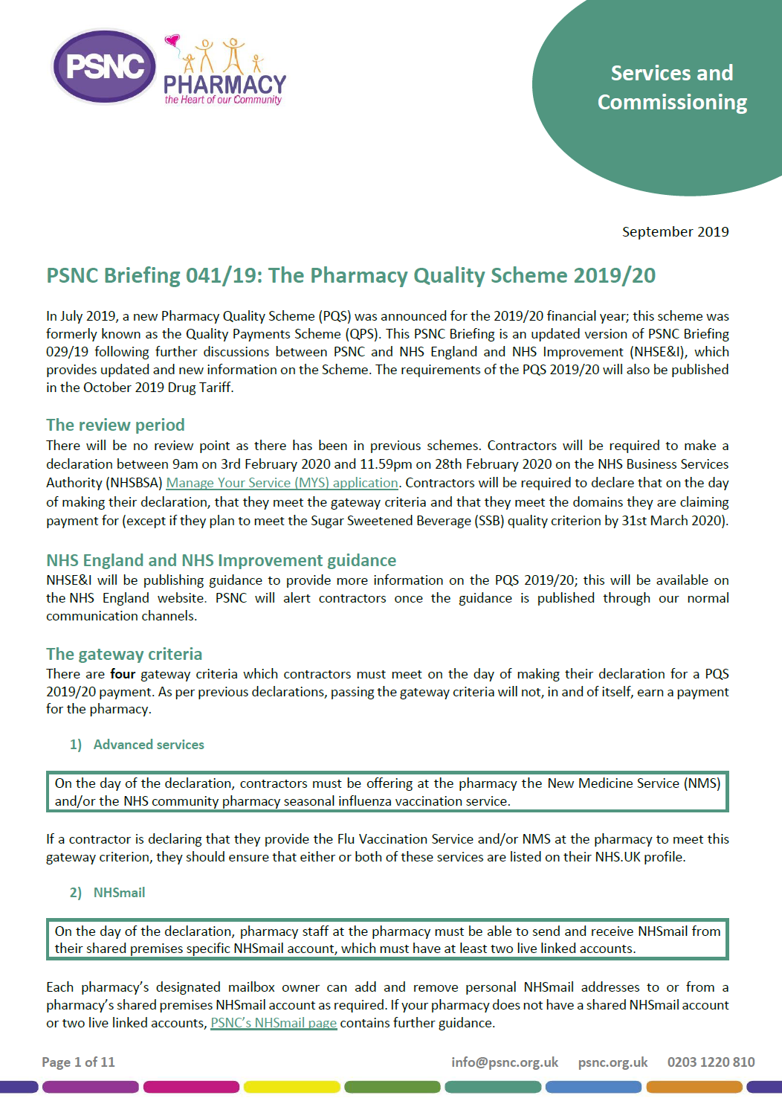
Quality - PQS declaration and guidance
Declaration period:
9am 3rd Feb - 11.59pm 28th Feb 2020
PSNC Briefing 041/19 contains the most up to date information
NHSE&I guidance will be published soon
Visit psnc.org.uk/PQS for more information

Slide 14
Pharmacy Access Scheme (PhAS) and consolidations
PhAS – same 2019/20 – 20/21 small changes scheme – 21/22 an updated and improved scheme
Aims to protect access, cost efficient, reasonably simple, simple and responsive
HMG –fewer pharmacies – dislikes cluster – making consolidations a better option
Admin improved DT/Regs
Notes:
The Pharmacy Access Scheme or PhAS continues as it is – at a cost of £24 million until April 19/20 when it will be updated and revised.
The details of the updated scheme will be available in October this year, 6 months before it is introduced.
The scheme has five main aims –
To protect access – the scheme assesses this though distance alone and not social factors, although in urban areas the distance is reduced in very deprived areas
To be cost efficient – because it is paid for by the contractor base – we have said that the scheme should not cost more that it does currently
To be not unduly administrative – if you remember the review process was lengthy and costly for contractors and the NHS alike - greater understanding of the mapping process would have reduced the number of reviews requests
To be reasonably simple to explain – this is helpful for all and links to the last aim but is particularly helpful for politicians if pharmacies start to close and the public needs reassurance that Government will maintain access to community pharmacies
And finally to be responsive – the last scheme has been relatively static and not taken account of closures and openings of pharmacies,

Slide 15
Funding - Short Term
Many aspects remain unchanged e.g. SAF, NMS, PhAS etc.
MUR + by 20/21 Establishment Payment phased out = unallocated funding
Monthly Transitional payments in H2 2019/2020 and 2020/21 to recognise costs (e.g. prep. for SSPs and implementation of FMD)
£10m set aside as a contingency for SSP payments – if not used, this will be added to Transitional payments
Additional SSP dispensing fee will be set at £5.35
CPCS fee will be set at £14.00

Slide 16
Funding - Long Term
Savings in cost of dispensing to free up funding and resources for value-added service delivery
PhIF to fund pilot services which may, if successful, be commissioned nationally
Discussions will be held on possible new funding models
PSNC and Government are committed to improving the current reimbursement arrangements

Slide 17
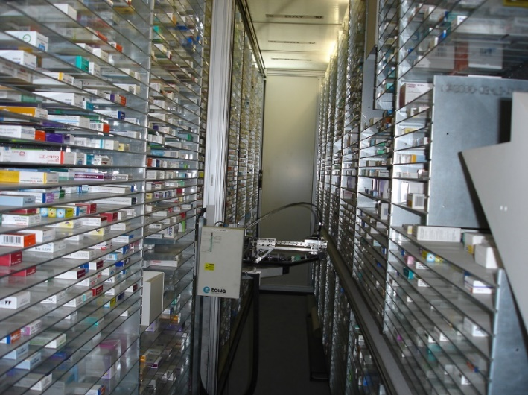
Enabling change and the use of technology
Government will pursue legislative change to allow all pharmacies to benefit from hub and spoke dispensing - agree with PSNC models to benefit the whole sector fairly
Why the change of approach by PSNC?
Others changes – DSP/B&M all pharmacies - funding work done/price differentials – terms of service – models of delivery
Notes:
The agreement makes clear that technology is considered to be an enabler to free up pharmacists’ time to provide services and for dispensing to become more efficient. There are a number of relevant issues here including hub and spoke dispensing between legal entities which PSNC successfully opposed in 2016.
So why accept it now. First, the introduction of technology is as stated inevitable so we cannot hold it off for ever and should seek to influence its introduction.
Second, as we recognised in 2016, there are efficiencies to be gained by hub and spoke dispensing currently undertaken currently by bigger contractors – this includes activity saving in the pharmacy which frees up pharmacists time in community pharmacies – so it could potentially help with the introduction of new services.
Third, Government has agreed to ensure that the whole sector – including Independents – can benefit from hub and spoke dispensing – so we should be able to influence how it is introduced in the NHS – perhaps through appropriate NHS regulations.
Perhaps the contentious issue is whether hub and spoke dispensing for Independents and between legal entities really will provide efficiencies or cost savings.

Slide 18
Patient choice and prescription direction
Government will continue to protect patients’ freedom to choose which community pharmacy dispenses their prescriptions
PSNC seeking a mechanism to tackle prescription direction
Notes:
First point - I think be clear here that all community pharmacies have the same obligations professionally for the patients they serve and for whom they dispense medicines – they are not remote hubs. Albeit within the context of different market entry requirements – bricks and mortar and DSPs. With such introductions as click and collect the distinction between the two is decreasing. We have concerns about any differential terms of service which then set up different SAF amounts which might set up a cost imperative for DSPs and at the same time might suggest the DSP does no more that assemble medicines and need not be patient focused. But we accept that the terms of service need to reflect patients’ increasing use of online services.
Second – the statement of patients’ free choice is helpful given some of the technological enablers and the concerns they present and behind this lies work to seek to ensure the NHS takes action to stop prescription direction – could mention evidence to DHSC regs review reporting in March 2018 that one pharmacy lost 95% of its business overnight due to prescription direction.

Slide 19
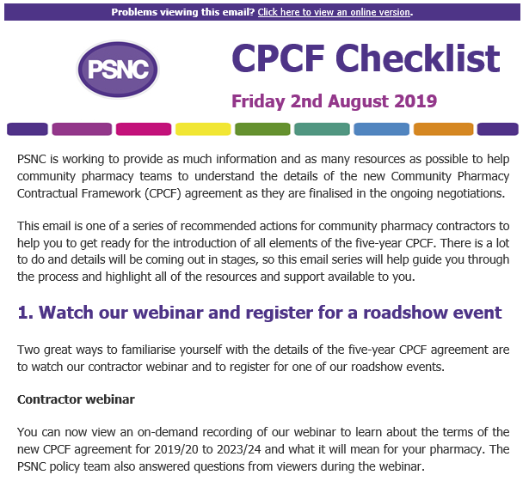
Further Support for Contractors
New Pharmacy Quality Scheme webpage with guidance on all PQS requirements: psnc.org.uk/PQS
Checklist e-mails to walk you through the changes and new services - sign up now psnc.org.uk/email
All guidance will be posted on psnc.org.uk

Slide 20
Checklist so far …..
Watch webinar
Register for MYS
Four CPPE – safeguarding, risk, sepsis and LASA
Check shared NHSmail account is in the pharmacy directory
Check pharmacy accredited as HLP level 1
Read CPCS service spec and register to provide on BSA MYS
Watch the PSNC CPCS webinar (yesterday evening)
Read the PSNC briefing on the PQS
Update MUR SOP by 1 October to reflect new targeting requirements

Slide 21
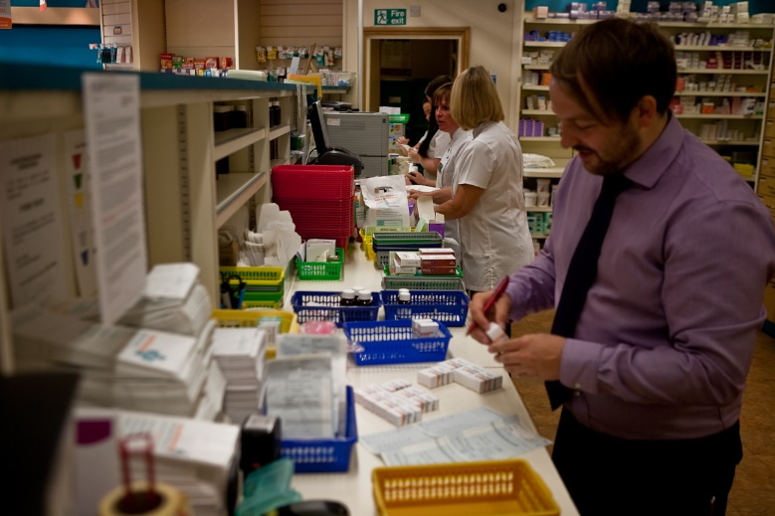
Challenges and change
Difficult financial situation and huge challenges ahead
Through annual reviews (which we secured) we will stress costs and manageability
Specific challenges will be around:
dispensing efficiencies
freeing up pharmacists’ time
wider use of clinical workforce
branch viability and consolidations
stopping unfunded services
coming together locally in PCNs
Notes:
Τηε δεαλ γυαραντεεσ τηε σεχτορ α φυτυρε – νοτ ονε τηατ ωιλλ βε εασψ το ατταιν, βυτ ονε τηατ δοεσ πρεσεντ οππορτυνιτιεσ φορ τηοσε ωηο αρε ωιλλινγ το ενγαγε ωιτη ιτ ανδ το χηανγε.
Ωηατ τηατ χηανγε μιγητ λοοκ λικε ισ σομετηινγ τηατ αλλ βυσινεσσεσ ωιλλ νεεδ το τηινκ αβουτ.
Ιτ ωιλλ μεαν λοοκινγ ατ τηε δισπενσινγ προχεσσ ανδ σεεινγ ηοω τηισ χαν βε μαδε μορε εφφιχιεντ το φρεε υπ πηαρμαχιστσ’ τιμε το φοχυσ ον χλινιχαλ σερϖιχεσ.
Φορ λαργε βυσινεσσεσ ιτ ωιλλ μεαν σομε διφφιχυλτ δεχισιονσ αβουτ τηε ϖιαβιλιτψ οφ σομε βρανχηεσ.
Φορ ινδεπενδεντ χοντραχτορσ, παρτιχυλαρλψ τηοσε ιν χλυστερσ οφ πηαρμαχιεσ, ιτ ωιλλ μεαν σομε ινχρεδιβλψ διφφιχυλτ χονϖερσατιονσ ωιτη οτηερ λοχαλ πηαρμαχψ βυσινεσσεσ το ωορκ τηρουγη ηοω ψου χαν δελιϖερ ωηατ τηε Γοϖερνμεντ ωαντσ ειτηερ ωορκινγ ιν παρτνερσηιπ, ορ εϖεν τηρουγη χονσολιδατινγ ψουρ βυσινεσσεσ.
Φορ εϖερψονε ιτ ωιλλ μεαν λοοκινγ ατ ψουρ βυσινεσσεσ ανδ στοππινγ δοινγ τηε τηινγσ ψου αρε νοτ παιδ φορ.
Ανδ νο ματτερ τηε σιζε οφ ψουρ βυσινεσσ, ιτ ωιλλ μεαν χομινγ τογετηερ ωιτη οτηερ πηαρμαχψ βυσινεσσεσ λοχαλλψ το ενσυρε τηατ ψου αρε αλλ α παρτ οφ τηε εμεργινγ ΠΧΝσ.

Slide 22
Business as Usual (BAU)

Slide 23
BAH – regulatory requirements
Terms of service – SSPs now part of these, relevant DT provisions included – OOP expenses; practice leaflets
Provider assurance – can lead to reclaiming overpayments; gateway criteria and bundles (breach notice and reclaim)
Market entry – most of new pharmacies DSPs; majority of applications for unforeseen benefits applications are refused
PCSE – Web portal for controlled stationery; new web portal for market entry applications due

Slide 24
BAU – regulatory requirements
Opening hours – notification > 3 months advance (PQS)
Quarterly reporting of MUR and NMS <10 days after Sept
CPAF ongoing – full CPAF or visit
Data Security and Protection Toolkit March 31
PSNC GDPR Toolkit
Annual CPPQ March 31
Two audits – choice and national
Complaints report ASAP after

Slide 25
BAU – regulatory requirements
Margin survey – fully backed up by Information and Disclosure regulations +
Regulations Review – recommendations included 100-hour pharmacies
FMD – picture unclear but whatever happens it’s likely UK will have a system to verify authenticity of medicines
GPhC – inspection report made public on new web portal

Slide 26
BAU – Flu vaccination service
Fee £8.08 per administered dose plus an additional fee of £1.50 per vaccination = total payment £9.58;
Due to the proven success of the service, contractors no longer required to ask patients to complete a patient questionnaire afterwards;
GP practice notification not by fax
Claims by NHSBSA MYS platform, monthly

Slide 27
Two Additional Topics

Slide 28
No-deal exit from the EU
PSNC working with DHSC and NHSE&I
PSNC working with the pharmacy sector
Contractor readiness – see PSNC website
Key message – don’t stockpile medicines beyond business as usual levels; report to PSNC – price concession
Serious shortage protocols – 5 different types – must consider, may supply if reasonable and appropriate; patient consent required; claim using NCSO – PSNC briefing and webinar

Slide 29
Provider companies
You have one – ahead of some
New model from PSNC
Key aspects – unity of all local pharmacies – PCN approach of cooperation – keeping costs low – funding from service rather than membership
Key need – delivery of services

